Slide 1
Thinking about Graphs
The Grammar of Graphics and SAS

Slide 2
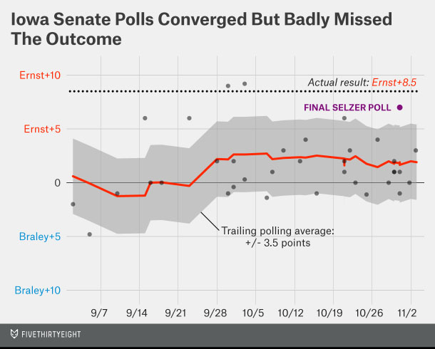
Reconstructing a graph
From
http://fivethirtyeight.com/features/heres-proof-some-pollsters-are-putting-a-thumb-on-the-scale/
Notes:
We are often asked to help someone reproduce a graph published somewhere, or produce a similar graph.

Slide 3
Questions toward reconstruction
What are the graphical elements?
How are they related to data?
How are they arranged on the screen/paper?
How are they decorated?
Notes:
Graphical elements: points, lines, shaded areas.
Relation: given in the data, or derived?
Screen layout: coordinates, scales.
Decoration: color, weight, pattern, annotation, etc.

Slide 4
Graphical elements
Points
Line(s)
Area
Notes:
This graph has all three!

Slide 5
Relation to data
Points: polling margins versus dates, essentially a scatter plot
Lines:
Grid lines, some emphasized
Trailing margin is polling averages versus dates, connected (a.k.a. a line plot)
Area: a fixed range around the trailing margin
Given the points, the lines and area can be calculated
Notes:
Points are essentially the observational data.
Lines are derived from the points.
Area is derived from the line.

Slide 6
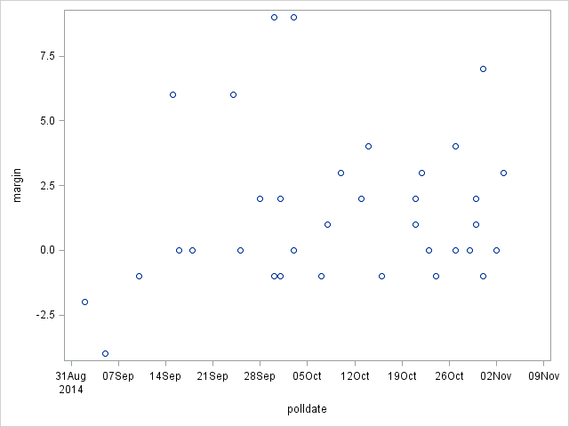
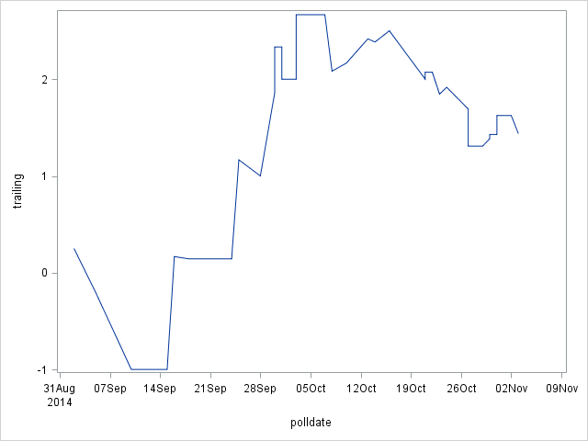
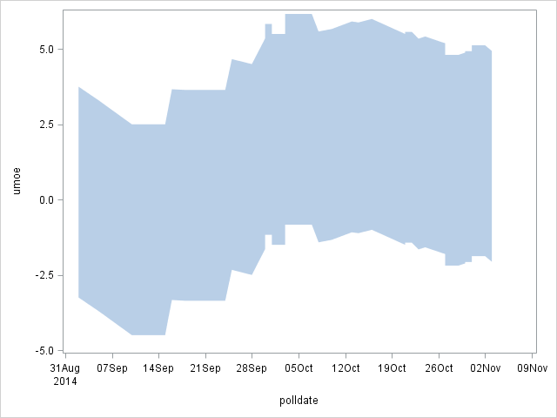
Arrangement
Think in layers, points on top of lines on top of area
Notes:
The order of the layers matters.
Lining things up means finding common scales and coordinates.

Slide 7
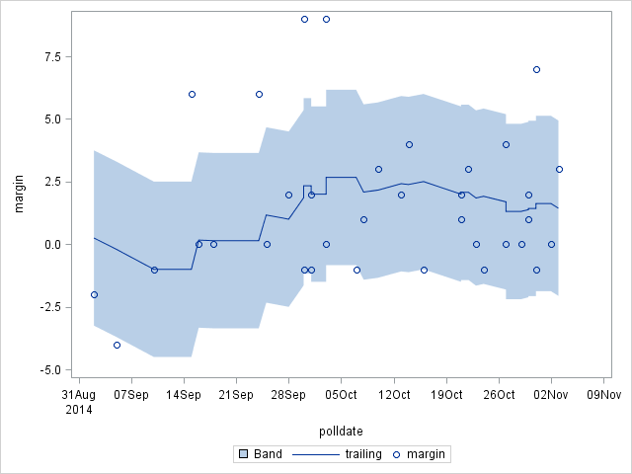
Layered together
Notice the scales now match.
The scales/coordinates are critical to how the elements are aligned on the page, and with each other.
Notes:
At it’s heart, this is it.

Slide 8
Decoration/Aesthetics
Titles and footnotes
Color, weight, etc. of graphical elements
Axis and legend text
Grid or guidelines
Etc. – there tend to be a large number of options at this point
Notes:
No we fix aesthetics for clarity.

Slide 9
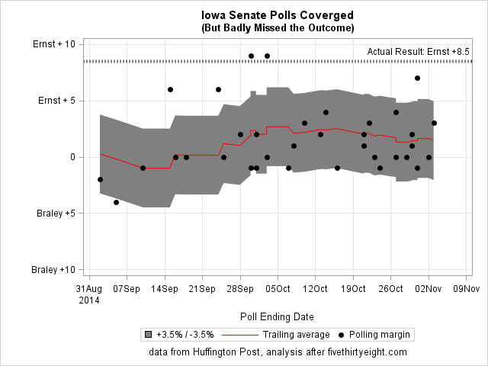
Reconstructed

Slide 10
Programming
The final program starts with the end result in mind
Get the data, convert data types and layout (long vs. wide) as necessary
Calculate data values needed
Specify the graphics

Slide 11
Get, clean, convert the data
data Iowapolls;
infile "Z:\PUBLIC_web\Stataworkshops\Grammar of Graphics\Iowa Huffingtonpost.csv"
firstobs=2 dsd dlm=",";
input Pollster :$46. Dates :$16. Pop $ Ernst Braley Undecided Spread :$10;
LV = (index(pop, "LV") gt 0);
if LV; *Just use "likely voter" polls, not "registered voters";
polldate = input(trim(substr(dates, index(dates, "-")+2))||"/2014", mmddyy10.);
format polldate mmddyy8.;
margin = Ernst - Braley;
run;
proc sort;
by polldate;
run;

Slide 12
Calculate other needed data
data Iowapolls2;
set Iowapolls;
retain w1 - w51 m1-m51;
array w {51};
array m {51};
w{_n_} = polldate;
m{_n_} = margin;
do i = 1 to _n_;
if w{i}+21 lt polldate then do;
w{i}=.;
m{i}=.;
end;
end;
trailing21 = mean(of m1-m51);
do i = 1 to 51;
if w{i} ne . then lastdate = w{i};
end;
format lastdate mmddyy8.;
drop w1 -- i;
run;

Slide 13
Calculate other needed data (cont.)
data trailing;
set Iowapolls2;
keep trailing21 lastdate;
by lastdate;
if last.lastdate then output;
run;
data Polls;
merge Iowapolls trailing(rename=(lastdate=polldate));
by polldate;
trailing = lag(trailing21);
lmoe = trailing - 3.5;
umoe = trailing + 3.5;
if polldate gt "01Sep2014"d;
run;

Slide 14
Basic graphical specification
proc sgplot;
band x=polldate upper=umoe lower=lmoe;
series x=polldate y=trailing;
scatter x=polldate y=margin;
run;

Slide 15
With decoration (setup)
proc format;
value margin -10 = "Braley +10"
-5 = "Braley +5"
5 = "Ernst + 5"
10 = "Ernst + 10";
run;
title "Iowa Senate Polls Coverged";
title2 "(But Badly Missed the Outcome)";
footnote "data from Huffington Post, analysis after fivethirtyeight.com";

Slide 16
With decoration (plot)
proc sgplot;
band x=polldate upper=umoe lower=lmoe / fillattrs=(color=gray)
legendlabel="+3.5% / -3.5%";
series x=polldate y=trailing / lineattrs=(color=red)
legendlabel="Trailing average";
scatter x=polldate y=margin / markerattrs=(symbol=circlefilled color=black)
legendlabel="Polling margin";
refline 8.5 / lineattrs=(pattern=dot thickness=4 color=black)
label="Actual Result: Ernst +8.5" labelloc=inside;
xaxis grid;
yaxis min=-10 max=10 grid label=" ";
label polldate = "Poll Ending Date";
format margin margin.;
run;

Slide 17
After all the steps

